Slide 1
Smart Teams™ Creating A Safe Concussion Reporting Environment: #TeamUp4ConcussionSafety
NCAA | DoD Mind Matters Challenge

Slide 2
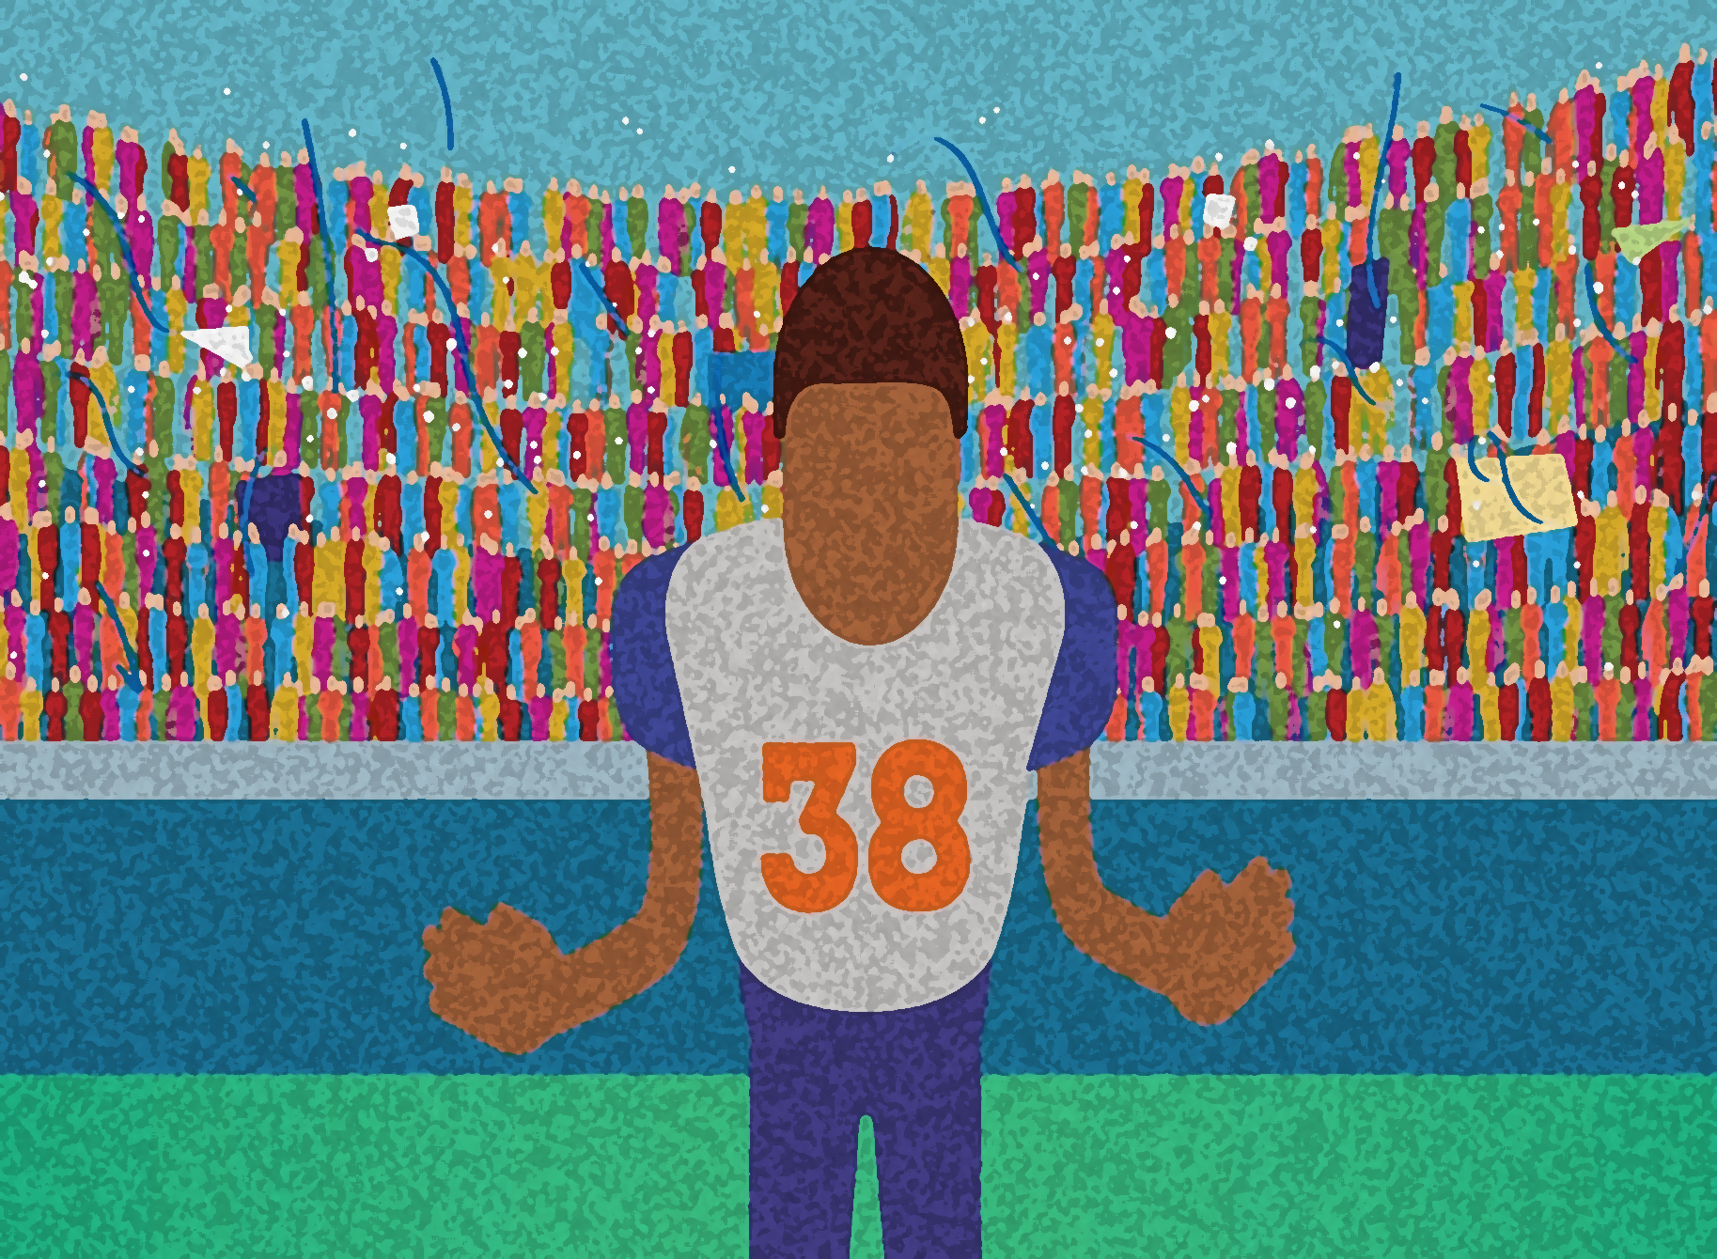
Why Do Athletes
Hide Concussion Symptoms?

Slide 3
Reasons Athletes Don’t Report
Don’t believe injury serious enough to report
Don’t want to be removed from the game or practice
Think can safely delay reporting until removal less likely to affect game or practice play or until symptoms gets so bad can’t keep playing
Don’t know potential health risks if keep playing
Don’t think suffered a concussion
Notes:
Research shows that between 40 and 60% of athletes don’t report concussion symptoms to the coach or athletic trainer or parent.
That means that a whole bunch of you in this room have probably hid concussion symptoms.
If you have hid concussion symptoms, I can almost bet that you have not reported symptoms for one or more of the reasons on this list.

Slide 4
Reasons Athletes Don’t Report
Expected to play hurt
Fear negative consequences if report symptoms
Feel pressure to keep playing from coaches, teammates, parents, and/or fans
Think that will be letting down coach, teammates, parents, and fans if report
Don’t think positive attitude toward reporting shared by coach and teammates

Slide 5
Concussion Symptom Reporting: A New Game Plan
Teach about concussion signs and symptoms and risks to short- and long-term health
Reduce pressure to hide symptoms
Create climate in which athletes feel comfortable reporting and encouraging teammates to report concussion symptoms
Involve all stakeholders
Notes:
We are pilot testing a brand new approach to concussion safety developed by a group of experts on concussion education called #TeamUp4ConcussionSafety™ program
First, we are going to go over the signs and symptoms of concussion so if you begin experiencing symptoms or see signs of concussion in one of your teammates, you can report them.
Second, we are going to talk about what can be done to reduce the pressure you feel as athletes to hide your symptoms and keep playing, whether it be from us as coaches, your parents, or even fans.
Third, we are going to try to create a climate in which, instead of fearing what your coaches, teammates, parents, and fans will think if you report, you feel that you won’t be penalized by a loss of playing time or have us think you have let us down by not continuing to play with concussion symptoms, but that you actually will be letting your team, the coaches, parents, and fans down if you don’t report.
And, fourth, the folks at SmartTeams believe that all of us – coaches, athletes, parents, and health care providers such as the team doctor and our athletic trainer – need to work as a team, need to team up for concussion safety, and that if we do, we are going to turn negative attitudes about reporting into a positive attitude towards reporting.

Slide 6
Concussion Symptom Reporting: #TeamUp4ConcussionSafety
Focus on the performance and health benefits of immediate concussion symptom reporting
Correct misperceived attitudes and beliefs by athletes about team concussion reporting attitudes
Establish immediate concussion symptom reporting as a valued team behavior and sign of a good teammate
Notes:
How are we going to do that?
By doing three things:
Focusing on how immediate reporting isn’t just a matter of avoiding further injury to your brain, but it can actually help our team perform better and maybe even win more games over the course of our season.
By getting all of us – coaches, players, parents, and the medical staff – on the same page when it comes to concussion symptom reporting. If, as one recent study of college athletes reported, three quarters of the athletes in this room believe you have safer attitudes about concussion than your teammates, we need to fix that perception.
By establishing honest reporting as something that we value on this team and sign of a good teammate so that, instead of feeling you have to hide your symptoms for fear of what the coaches, your teammates, your parents, or even the fans in the stands might think, you will know that none of us are going to see it as a sign of weakness, but as a sign of strength and being a good – and smart – player.

Slide 7
Concussion Signs and Symptoms
Mental status
Eyes
Emotional
Balance
Memory
Nausea/vomiting
Motor
Pain
Concussion Signs and Symptoms
© MomsTeam Institute, Inc. | SmartTeams project
Notes:
If you have taken the quizzes and concussion education course on the SmartTeams website, you probably already know something about signs and symptoms of concussion, but, just to review, here are the symptoms athletes experience when they have suffered a concussion:
Altered mental status: feeling in a fog, not with it, glazed over, talking nonsense, can’t focus, disoriented, blacking out, nonresponsive
Eyes: eyes dilated, glassy eyed, eyes rolling back in head, eyes looking nowhere, loss of vision, squinting a lot
Pain: headache, sensitivity to lights and sounds, throbbing, ringing in ears
Balance: loss of balance, stumbling, dizziness, not able to walk straight
Memory: forgetting things, don’t remember what happened, memory loss
Nausea/vomiting: vomits, sick to stomach, feeling nauseous
Motor: Down on knees, trouble getting up, can’t stand up straight, slurred words, feeling slowed down, slower to react
Emotional: changes in mood, crying, irritability

Slide 9
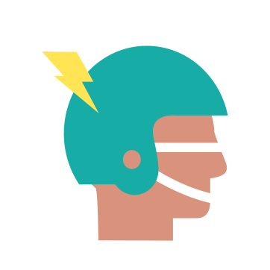
Concussions Are Serious!
Concussion is a form of traumatic brain injury which changes how the brain functions
Once considered a temporary injury
Now recognized as a complex injury with both short-term and long-term effects
Notes:
Concussions are injuries to the brain so they have to be treated seriously – no ands, ifs, or buts.
While most of the obvious concussion symptoms are usually gone within 7 to 10 days (assuming you report your symptoms right away and don’t keep playing), scientists are finding, by using advanced imaging techniques to scan the brain, that a concussion’s effects on the brain, on the way you think, on your balance, on your memory, can be much more long-lasting.
The more we know about concussions and their effects, the more complex the injury is becoming.

Slide 10
Playing With Concussion Symptoms Puts Athlete’s Health At Added Risk
Continuing to play with concussion symptoms exposes athletes to increased risk of:
more serious brain injury, up to and in rare cases including death
other kinds of injury
Notes:
When you have suffered a concussion, science tells us that your brain is very vulnerable to further injury, so that if you keep playing with a concussion, you are at increased risk of injuring your brain even more, or, in rare cases, suffering catastrophic injury.
Because a concussion effects your balance, your reaction time, and your ability to think clearly, you are also at risk of other kinds of injury, like having your knee blown out, or a badly sprained ankle.

Slide 11
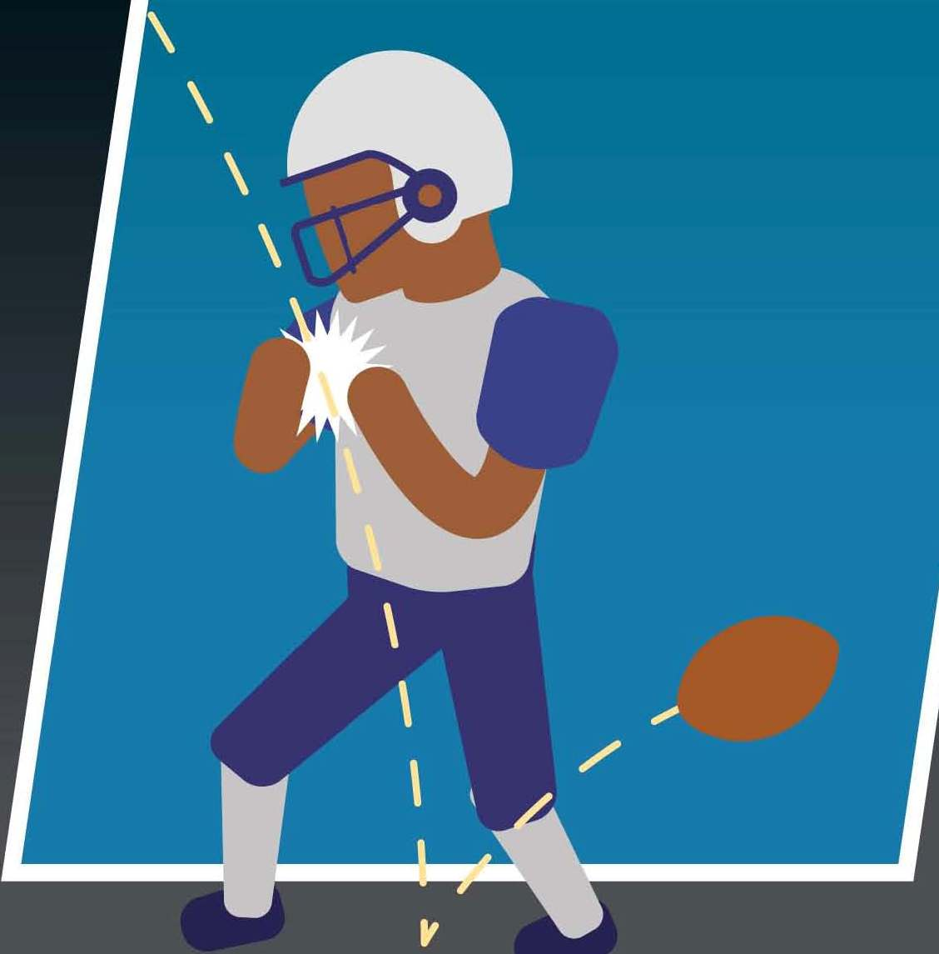
Playing With Concussion Hurts Athlete and Team Performance In That Game
Hard for concussed athletes to play their best:
slower reaction times
balance problems
impaired thinking and memory
Continuing to play with concussion symptoms could hurt team’s performance and chances of winning
Notes:
This is a key point:
Because concussion hurts reaction time, thinking, balance, and memory, it makes sense that, after an athlete suffers a concussion, player performance suffers, and
When an individual player’s performance suffers, the overall team’s performance is likely to suffer as well, and that could mean hurting our team’s chances of winning.
If you scrolled down the page on the SmartTeams concussion website, you saw what happened to Jake and his team when he stayed in the game with a concussion. What happened? His team lost as a direct result of his inability to perform at his best.

Slide 12
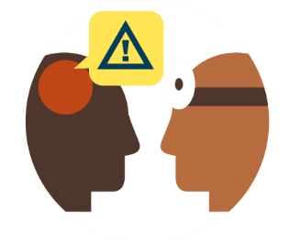
Delayed Concussion Symptom Reporting Hurts Athlete And Team In Future Games
Concussed athletes who delay reporting :
Are 8 times more likely to need 21 or more days to get medical clearance to return to contact
Take nearly twice as long to return from injury (44 days v. 22 days)
Perform significantly worse on tests of verbal and visual memory, processing speed, and reaction time,
report more severe concussion symptoms at their initial and follow-up visits
Hurt themselves and their team by missing
more time
© MomsTeam Institute, Inc. | SmartTeams project
Notes:
A new study shows that athletes who immediately report concussion symptoms, are removed from the game, and later diagnosed with a concussion, come back 20 days faster on average than concussed players who don’t report symptoms right away and keep playing.
Athletes who don’t report right away are 8 times more likely to take 21 or more days to be cleared to return for contact.
Hiding your symptoms is simply a bad bet because it is likely means that you are going to be out a lot longer. Miss one or two games or perhaps the whole season. The choice is yours.

Slide 13
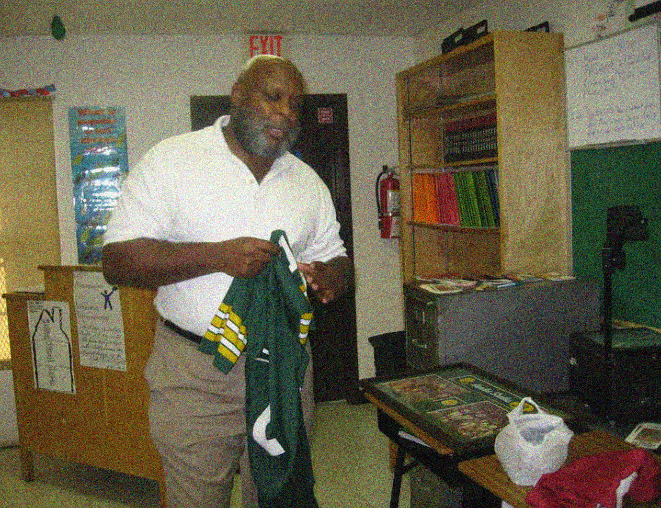
“I know I would have added years to my playing career if only I reported my concussions”
Hurles Scales, Former NFL Player

Slide 14
Immediate Concussion Symptom Reporting Helps Team And Athlete
Teams benefit:
Ensure that injured players don’t hurt performance
Athletes return more quickly after injury
Athletes benefit:
Have best chance to return to sports as quickly as possible.
Notes:
The key message for all of us here today is that conservative concussion safety practices, that a culture of concussion safety in which immediate reporting of concussion symptoms is the rule, not the exception, can be created without negatively affecting personal and team goals such as winning, and may actually help us achieve those goals.

Slide 15
Four Signs Of Good Teammate
Self-report concussion symptoms immediately
Watch for concussion signs in teammates
Encourage teammate with suspected concussion to report to coach or medical staff
Ask for teammate to be checked out if they won’t self-report
Notes:
What we want you all to leave this room knowing is what it means to be a good team player:
It isn’t hiding your symptoms,
It isn’t keeping quiet when you see a teammate struggling to shake off a hard hit
It isn’t believing that your teammates wouldn’t want you to encourage them to report experiencing symptoms or telling a coach or the athletic trainer to have you checked out for concussion.
It is exactly the opposite!

Slide 16
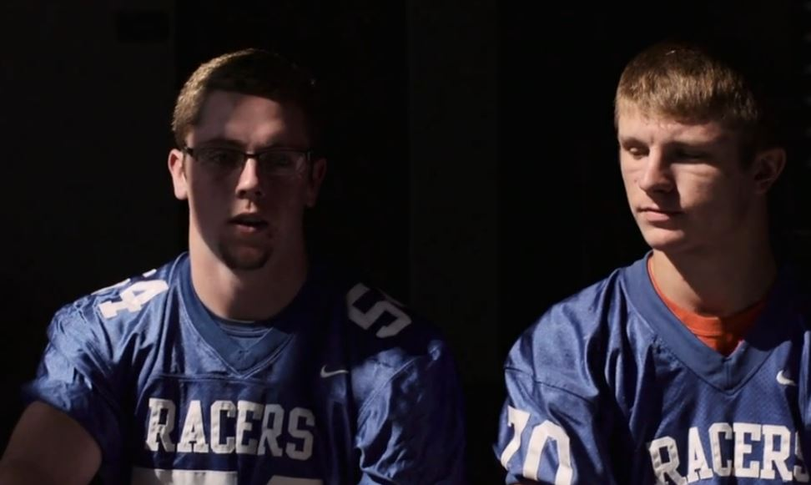
"I have a friend on the line. He's the center. We were at practice one day, and he seemed really out of it. So, I told coach, and he got really mad. But I know it was going to help him in the long run.“
- TTT

Slide 17
Coach’s Concussion Pledge
Help athletes feel comfortable reporting concussion symptoms (own and teammates)
Stress athletes’ responsibility to report symptoms (own and teammates)
Reinforce positive concussion reporting messages during season
Create and maintain open dialog with players about concussion safety
Notes:
To show our commitment to concussion safety, everyone here, coaches, players, and parents, are being asked to sign a pledge.

Slide 18
Athlete’s Concussion Pledge
All concussions are brain injuries which athlete has responsibility to report
Own health and safety and that of teammates always more important than winning
Will report concussion symptoms to help team win that game and future games

Slide 19
Parent’s Concussion Pledge
Stress to athlete that immediate symptom reporting in both their best interests and their team’s
Watch for delayed concussion symptoms or signs of more serious brain injury
Avoid putting pressure on child to continue playing after hard hit to head
Not pressure coach or doctor to return child to play before brain fully healed

Slide 20
We Can Be Concussion Smart And Win Too!

Slide 21
Brooke de Lench
Executive Director
MomsTEAM Institute, Inc.
delench@MomsTeam.com
Lindsey Barton Straus, JD
Sr. Health and Safety Editor/ Researcher
MomsTEAM Institute, Inc.
lbartonstraus@MomsTeam.com

